Slide 1
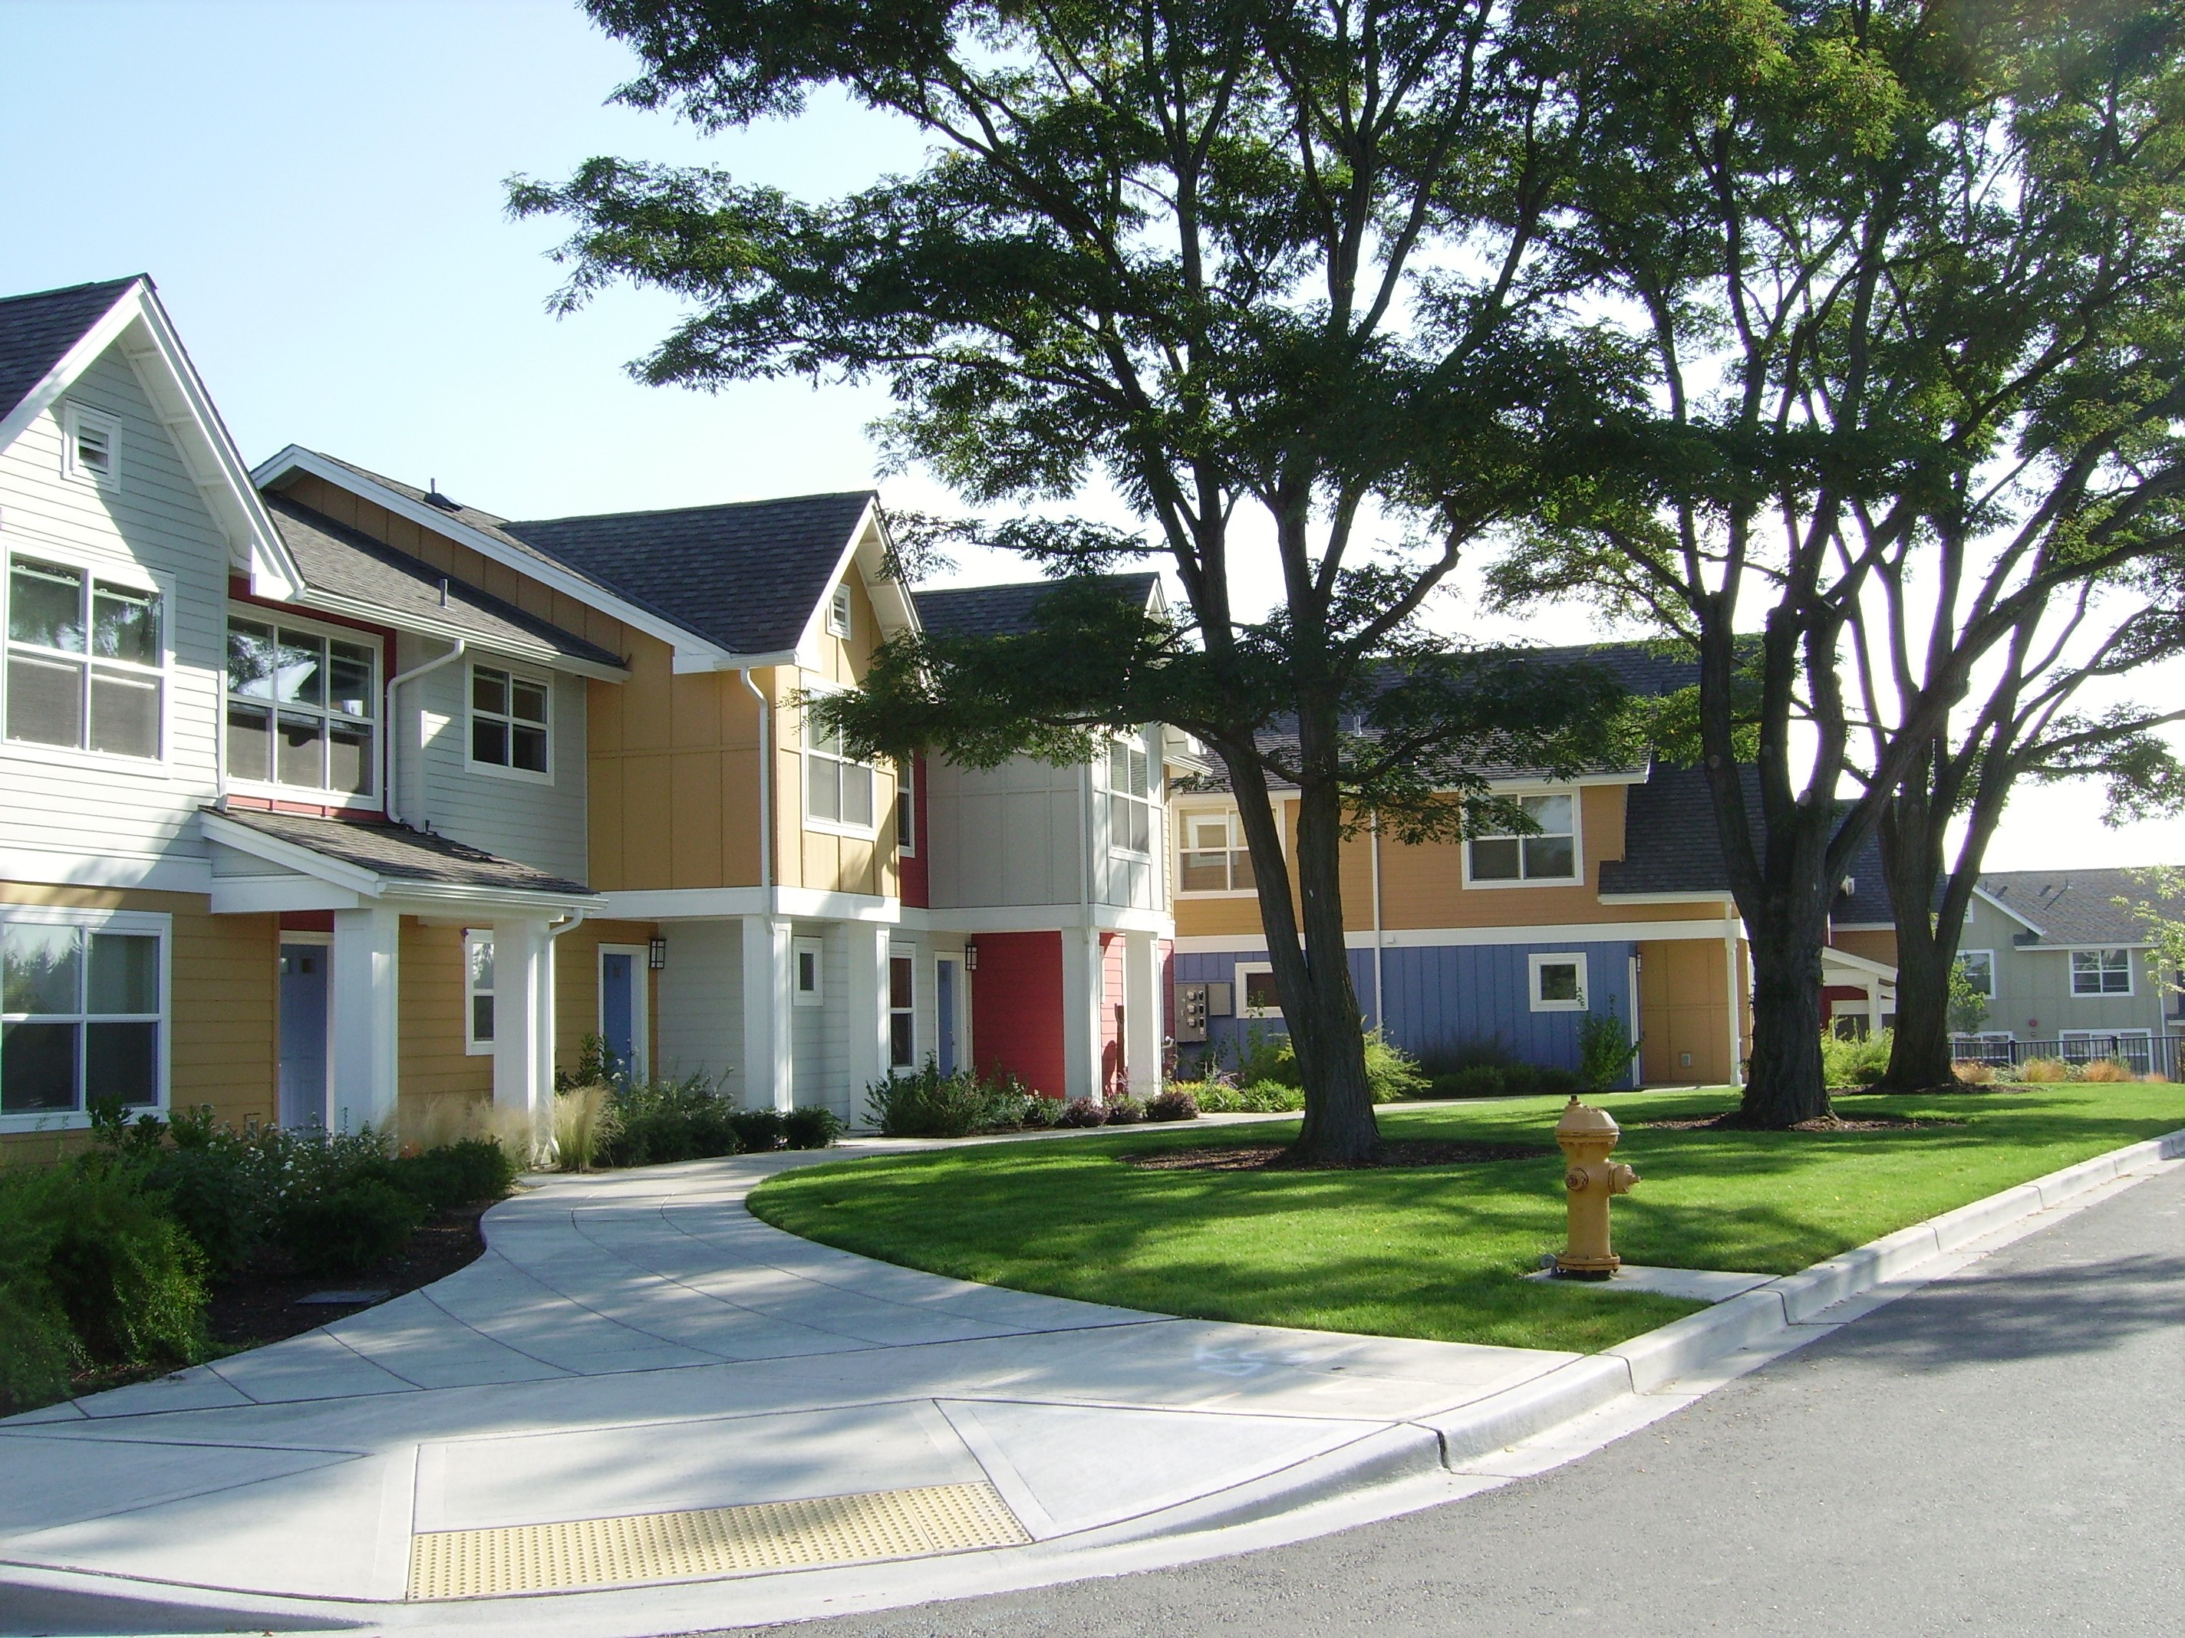
Module 2 Final Project
King County Housing Data
April 2021
Lyndsay Maggin

Slide 2

Scenario
It is 2016 and I am a realtor in the King County Washington area working with a new family to find their forever home. Using the 2014/15 King County Home Sales dataset, with my newly learned data science tools, I can predict the proper value of a property of interest and therefore can assist the family in entering a proper bid

Slide 3
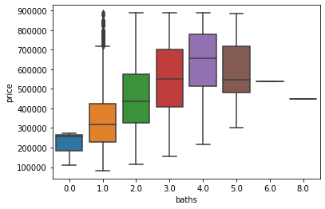
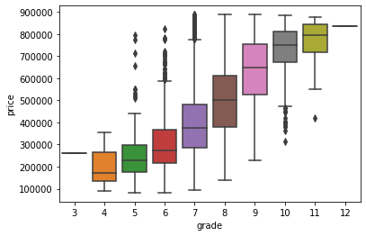
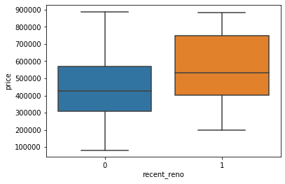
Getting to Know the Data

Slide 4
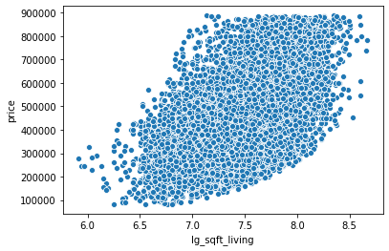
Data Standardization
In order to improve normality of continuous variables, I logged and standardized.
Standardization also helps to reduce multicollinearity among predictors.
Correlation between sqft living and sqft lot was .14.

Slide 5
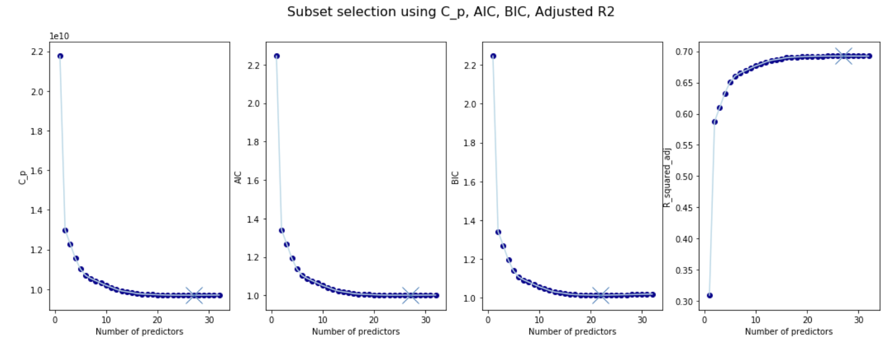
Choosing the Best Predictors
Using Mallow’s Cp, I determined 25 to be the best number of predictors for my model
The more predictors you use, the less explanatory power you will have, I optimized the model using best subsets

Slide 6

Multivariable Regression
Using K-Folds to train and test the model on 25 predictors, my model resulted in:
Rsquared: 69%
Mean Squared Error: $98,781
Therefore I can assume that if I predict a housing price using my regression model, the price I predict could be off by about $98,781

Slide 7
Prediction
My client is currently looking at the following home close to Medina:
3 bed
4 bath
3,481 sqft livable space
Built in 2006
16,988 sqft lot
gorgeous views of the water
highly rated
The home is pricing for $899,900 today, is this a competitive price for them?
Using my model, I predicted a property value of $927,404.08
We can therefore assume this property is undervalued and my client should enter a bid
Adjusting for MSE the lowest bid I would suggest is ~$828,000 ($927,404.08-$98,781.00)

